Slide 1
What is Classification?
Classification is a systematic grouping of observations into categories.
Example: In Malaysia we classify our vehicle by size into Class 1 to 5

Slide 2
How does AI Classification works
Provide data to AI, the algorithm studies the information in the database.
AI will classify them into category.
Example: AI has the ability to categorize grocery items into different category such as food, laundry ETC.

Slide 3
Implementation
We collect require data such as Restaurant, Food type, Location, Ration, Price.
Classify the restaurant by the data above.
System will study the data and sort them automatically.

Slide 4
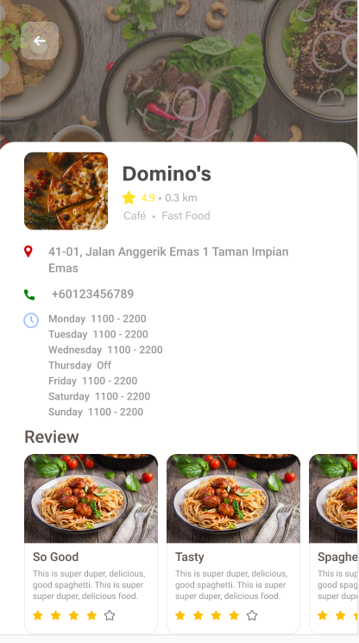
Picture shows their
-Food type
-Location
-Rating

